Slide 1
Cloud Simulators

Slide 2
Syllabus
CloudSim and GreenCloud
Introduction to Simulator
Understanding CloudSim simulator
CloudSim Architecture(User code, CloudSim, GridSim, SimJava) Understanding Working platform for CloudSim
Introduction to GreenCloud.

Slide 3
Introduction to Simulator
Although cloud computing‘s inception spans over a decade, still there are many challenging issues which requires a significant amount of research to be done.
It is impractical for medium to small sized educational institutions and other organizations to establish a physical cloud for conducting research on cloud computing.
It is not possible to perform benchmarking experiments in repeatable, dependable, and scalable environments using real-world cloud environments.
A solution for this is to use simulators (virtual reality) which can simulate a real cloud environment.

Slide 4
A cloud simulator helps to model various kinds of cloud applications by creating data centers, virtual machines and other utilities that can be configured appropriately, thus making it easier to analyze.
To date many cloud simulators had been developed and are being actively used to conduct cloud research.

Slide 5
Example of Simulators
CloudSim
CloudSim is the most popular simulation tool available for cloud computing environment.
CloudAnalyst
Wickremasinghe developed a new simulator called CloudAnalyst which is based up on CloudSim.
CloudAnalyst was basically developed for evaluating the performance of large-scale distributed cloud applications having high user workload that are geographically distributed over several data centers.

Slide 6
GreenCloud
GreenCloud is a packet level simulator developed by extending network simulator NS2. CloudSim, and is specially made for energy-aware environment. GreenCloud is designed so that it can calculate energy consumption at any particular data center components such as link, switch, gateway etc. as well as communication between the packet levels. Further, it offers to know the workload distribution in the system.

Slide 7
iCanCloud
iCanCloud is developed by considering the drawbacks of previous mentioned simulators like CloudSim and GreenCloud. This simulator was developed based on SIMCAN.
The unique feature of iCanCloud is that the user can customize the core hypervisor class. Base programming language used for iCanCloud is C++.

Slide 8
NetworkCloudSim
It is an extension of CloudSim. CloudSim and GreenCloud are basically built for single server architecture and becomes insufficient for real cloud model which involves deploying different types of applications from different customers. NetworkCloudSim supports communication between application elements and various network elements.

Slide 9
EMUSIM
EMUSIM is not only a simulator; it provides both the capabilities of an emulator as well as simulator of a cloud environment. It is developed for CPU intensive SaaS applications which are very costly for actual deployment. For these types of applications customer has to analyze the behavior of the application before subscribing for a cloud plan. EMUSIM is built up on CloudSim and Automated Emulation Framework (AEF).

Slide 10
GroudSim
GroudSim(Gr-Grid and oud-Cloud Simulator) is a discrete event simulation platform for both cloud and grid computing environments. It is specifically developed for simulating scientific applications in grid and cloud environments.
DCSim
DCSim simulator was developed to simulate a virtual data center in IaaS model. The data center contains multiple interconnected hosts and each host having its own CPU scheduler and resource management policy. It also supports VM migration among the hosts and sharing of workload between multiple VMs. DCSim simulates data center with centralized management system and neglects data center network topology for higher scalability.

Slide 11
MR-CloudSim [20]
MR-CloudSim was developed based on CloudSim simulator. The unique feature of MR-CloudSim is its support for simulating MapReduce tasks and there by supporting BigData processing. CloudSim simulator does not support file processing, cost and time associated with it. In MR-CloudSim, authors changed some of the core classes in CloudSim to support MapReduce programming model.

Slide 12
SmartSim
SmartSim is uniquely built for simulating applications for mobile cloud computing. SmartSim is the first ever simulator built that supports mobile cloud applications. Its main feature is to model mobile cloud application running in mobile devices.
SimIC
SimIC is a discrete event simulator built up on the SimJava Package. Recent research is geared towards federated clouds, thus exchanging many services between different cloud data centers and eventually increasing quality of service. None of the above mentioned simulators can simulate inter-cloud activities effectively.

Slide 13
SPECI
SPECI(Simulation Program for Elastic Cloud Infrastructures) is a discrete event simulation tool that enables exploration of scaling properties of large data centers. The aim of this project is to simulate the performance and behaviour of data centers, given the size and middleware design policy as input. SPECI is built with SimKit which in turn is developed in Java. SPECI does not provide any support for VMs, load balancing, security and job scheduling.
DynamicCloudSim
DynamicCloudSim is an extension of CloudSim which is able to simulate instability caused due to heterogeneous nature of cloud computing, dynamic changes due to several factors at runtime and failures during task execution.

Slide 14
CloudSimSDN
CloudSimSDN based on CloudSim is a lightweight and scalable simulation environment to analyse the network allocation capacity policies like measuring the network performance and host capacity allocation approaches simultaneously within a data center.
secCloudSim
secCloudSim is an extension of iCanCloud simulator which provides security features like authentication and authorization which are not addressed by any of the existing simulators.

Slide 15
CEPSim
CEPSim (Complex Event Processing Simulator) is an extension of CloudSim that allows researchers to work with cloud applications that are modeled based on directed acyclic graphs used to represent continuous CEP queries. A key feature of CEPSim is it allows researchers to simulate queries in heterogeneous cloud environments under different load conditions. One drawback of this simulator is dynamic query analysis is not supported.
PICS
PICS(Public IaaS Cloud Simulator) is a simulator designed from cloud user perspective to evaluate the cost and performance of public IaaS cloud along dimensions like VM, storage service, resource elasticity, job scheduling and diverse workload patterns.

Slide 16
Understanding CloudSim simulator
CloudSim is an open-source simulation toolkit that allows users to model and simulate cloud computing environments.
It provides a framework for simulating the behaviour of cloud resources, data centers, virtual machines (VMs), and cloudlets (tasks) without needing to deploy physical infrastructure.
This makes CloudSim an invaluable tool for researchers experimenting with different cloud computing strategies, testing resource allocation algorithms, or optimising cloud performance.

Slide 17
Benefits of Simulation over the Actual Deployment:
No capital investment involved. With a simulation tool like CloudSim there is no installation or maintenance cost.
Easy to use and Scalable. You can change the requirements such as adding or deleting resources by changing just a few lines of code.
Risks can be evaluated at an earlier stage. In Cloud Computing utilization of real testbeds limits the experiments to the scale of the testbed and makes the reproduction of results an extremely difficult undertaking. With simulation, you can test your product against test cases and resolve issues before actual deployment without any limitations.
No need for try-and-error approaches. Instead of relying on theoretical and imprecise evaluations which can lead to inefficient service performance and revenue generation, you can test your services in a repeatable and controlled environment free of cost with CloudSim.

Slide 18
Why use CloudSim?
Below are a few reasons to opt for CloudSim:
Open source and free of cost, so it favours researchers/developers working in the field.
Easy to download and set-up.
It is more generalized and extensible to support modelling and experimentation.
Does not require any high-specs computer to work on.
Provides pre-defined allocation policies and utilization models for managing resources, and allows implementation of user-defined algorithms as well.
The documentation provides pre-coded examples for new developers to get familiar with the basic classes and functions.
Tackle bottlenecks before deployment to reduce risk, lower costs, increase performance, and raise revenue.

Slide 19
Features of CloudSim:
CloudSim provides support for simulation and modelling of:
Large scale virtualized Datacenters, servers and hosts.
Customizable policies for provisioning host to virtual machines.
Energy-aware computational resources.
Application containers and federated clouds (joining and management of multiple public clouds).
Datacenter network topologies and message-passing applications.
Dynamic insertion of simulation entities with stop and resume of simulation.
User-defined allocation and provisioning policies.

Slide 20
Architecture of CloudSim
The architecture of CloudSim is a layered framework designed to model and simulate cloud computing environments. It leverages existing simulation libraries to handle low-level operations, allowing developers to focus on high-level cloud-specific logic.

Slide 21
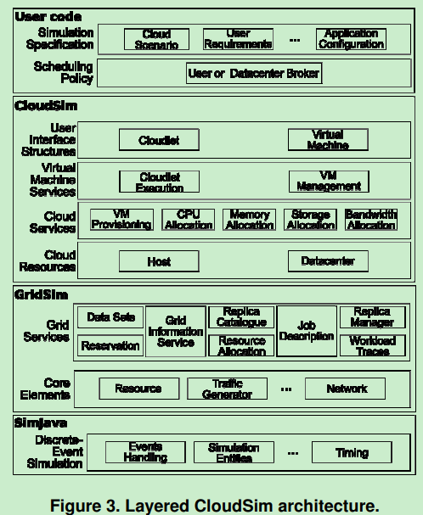

Slide 22
User Code (Top Layer): This is the interface where developers define their specific simulation scenarios.
It includes:
Cloud Scenarios: Defining the number of users, types of applications, and virtual machines (VMs).
Custom Policies: Implementing specific scheduling algorithms (like FCFS or Round Robin) and resource provisioning strategies.
Configurations: Setting hardware specifications for hosts, such as CPU cores, RAM, and bandwidth.

Slide 23
CloudSim (Second Layer): This layer provides the core cloud-specific simulation functionalities.
It manages:
Core Entities: Managing the lifecycle (creation, execution, and destruction) of VMs, Cloudlets (tasks), and Hosts.
Resource Provisioning: Handling how physical resources are allocated to VMs based on user requests.
Dynamic Monitoring: Tracking resource utilization and application execution in real-time.

Slide 24
GridSim (Third Layer): CloudSim extends the GridSim Toolkit to handle distributed resource management.
It provides:
Grid Modeling: Infrastructure for modeling grid-based entities like users, machines, and networks.
Information Services: Handling resource discovery and registration across multiple simulated organizations.
Networking Support: Managing the communication and data transfer between different system components.

Slide 25
SimJava (Bottom Layer): At the foundation, SimJava serves as the low-level discrete-event simulation engine.
It handles:
Event Management: Queuing and processing events to advance the simulation clock.
Message Passing: Facilitating communication between different simulation entities through event objects.
Parallel Execution: Using Java threads to execute multiple simulation entities concurrently.

Slide 26
Understanding Working platform for CloudSim
The CloudSim API is the backbone of the CloudSim simulation toolkit. It provides a set of Java-based libraries and tools that enable users to create detailed cloud simulations.
It is further bundled and shipped as a JAR file, and that is known as CloudSim API.

Slide 27
Core Components of CloudSim API
To effectively use the CloudSim API, it’s crucial to understand its core components and how they interact within a simulation. Here are the primary components you’ll work with:
Datacenter: Represents the physical infrastructure where resources like CPU, memory, storage, and bandwidth are allocated.
Host: A physical machine within a data center that houses one or more virtual machines (VMs).
VM (Virtual Machine): A software-based simulation of a physical machine that runs on a host and executes tasks (cloudlets).
Cloudlet: Represents the tasks or jobs submitted to the cloud infrastructure, which are then processed by VMs.
DatacenterBroker: Manages the distribution of cloudlets to VMs and monitors their execution.

Slide 28
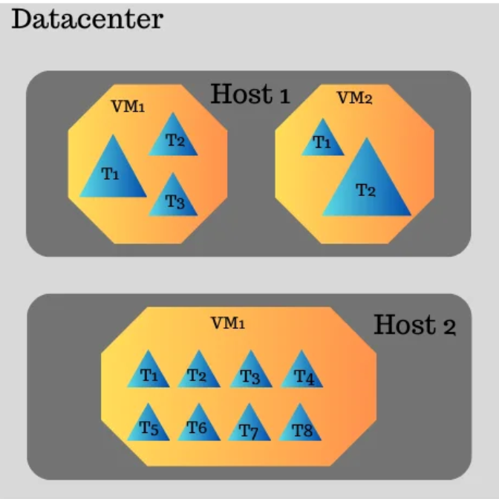
The figure displayed will basically help you visualize on how the simulation engine of Cloudsim simulation toolkit performs the resource allocation where the datacenter model will hold the host models and this host model further host the one or more virtual machines and each virtual machine will hold certain allocated task for the task execution simulation.

Slide 29
How CloudSim API for Cloud Simulations Works
The CloudSim API for cloud simulations works by providing a hierarchical structure of classes and methods, each designed to simulate a specific aspect of cloud computing.
Here’s a step-by-step breakdown of how the CloudSim API operates:
Initialization: The simulation begins with the initialization of the CloudSim environment and the creation of data centers, hosts, VMs, and cloudlets.
Resource Allocation: The DatacenterBroker allocates resources to VMs and assigns cloudlets to VMs based on predefined policies.
Task Scheduling: The API provides various scheduling algorithms (e.g., time-shared, space-shared) to determine how cloudlets are processed by VMs.

Slide 30
Execution and Monitoring: Once the simulation starts, CloudSim API manages the execution of cloudlets on VMs, monitors resource utilization, and tracks metrics like execution time and energy consumption.
Results Analysis: After the simulation completes, the API provides detailed results that can be analyzed to understand the performance of the simulated cloud environment.

Slide 31
Setting Up Your Development Environment
Before you can start using the CloudSim API for cloud simulations, you must set up a Java development environment.
The following steps will guide you through the setup process:
Download CloudSim: You can download the latest version of CloudSim from its official GitHub repository.
Set Up Your IDE: Use an Integrated Development Environment (IDE) like Eclipse or NetBeans for developing your simulation. Create a new Java project in your IDE.
Add CloudSim Libraries: Import the CloudSim JAR files into your project. These files contain the necessary classes and methods to run cloud simulations.
Write Your Simulation Code: With everything set up, you can now start writing your simulation code using the CloudSim API.

Slide 32
Exploring the Packages in CloudSim API
The CloudSim API is organized into several packages, each serving a specific purpose in the simulation process.
Understanding these packages is key to effectively using CloudSim for your research.
org.cloudbus.cloudsim.core
Purpose: Contains the model classes responsible for simulating CloudSim entities, which play a crucial role in cloud simulation.
Usage: This package is essential for setting up and controlling the simulation environment. It manages the lifecycle of the simulation and handles interactions between different cloud entities through events.

Slide 33
org.cloudbus.cloudsim
Purpose: Provides the fundamental classes that define the key components of a cloud simulation, such as datacenters, hosts, VMs, and cloudlets.
Usage: Use this package to define and manage the core components of your cloud simulation. It’s where you set up datacenters, create VMs, submit cloudlets, and manage resource allocation.
org.cloudbus.cloudsim.provisioners
Purpose: Manages the provisioning of cloud resources like CPU, RAM, and bandwidth.
Usage: When defining hosts and VMs, this package allows you to specify how resources are allocated and managed during the simulation.

Slide 34
org.cloudbus.cloudsim.schedulers
Purpose: Contains classes that define how cloudlets are scheduled on VMs and how VMs are scheduled on hosts.
Usage: Use this package to define the scheduling policies that determine how tasks are executed within VMs and how VMs are allocated to hosts.
org.cloudbus.cloudsim.power
Purpose: Dedicated to simulating energy consumption in cloud data centers, with a focus on energy-efficient resource management and VM allocation.
Usage: Essential for conducting energy-aware simulations in CloudSim, allowing you to model and optimize the power consumption of cloud data centers.

Slide 35
org.cloudbus.cloudsim.network
Purpose: Provides classes for simulating network behavior within a cloud environment, including data transmission and network delays.
Usage: This package is crucial for simulations where network behavior plays a significant role, such as modeling data transfer delays and bandwidth usage.

Slide 36
Challenges and Considerations When Using CloudSim API
While the CloudSim API for cloud simulations is a powerful tool, it comes with its challenges:
Steep Learning Curve: The API can be complex for beginners, requiring a solid understanding of Java programming and cloud computing concepts.
Limited Real-Time Support: CloudSim is designed for simulation rather than real-time execution, which means it may not fully capture the behavior of live cloud environments.
Customization Needs: Depending on the complexity of the simulation, you may need to develop custom components, which can be time-consuming.

Slide 37
Reference
https://cloudsimtutorials.online/cloudsim-api-for-cloud-simulations/

Slide 38
GreenCloud
According to a European Commission study on energy-efficient cloud computing technologies published in 2020, data centers accounted for 2.7% of the European Union's electricity demand in 2018, and this is expected to reach 3.21% by 2030 if demand continues its current trajectory. The U.S. Department of Energy has said data centers account for about 2% of the country's total electricity consumption, and the International Energy Agency estimated in a September 2022 report that up to 1.3% of worldwide electricity usage in 2021 was in data centers.

Slide 39
By all those measures, data centers are consuming a significant amount of energy overall, and this usage will only accelerate as digital transformation initiatives in companies further expand and data center growth continues. In particular, cloud data centers often are behemoth facilities, housing thousands of servers, numerous racks of storage devices, miles of networks and the peripheral infrastructure necessary to keep everything running. To address the environmental challenges associated with these facilities, cloud service providers have been adopting green cloud practices to varying degrees, more so in areas under public scrutiny.

Slide 40
In this sense, green cloud computing refers to the steps that service providers are taking to improve the environmental profiles of their data centers by implementing green computing approaches. The resulting green clouds can also contribute to broader environmental, social and governance (ESG) programs at the cloud vendors themselves and companies that use their services. Greener IT is a common component of corporate ESG initiatives, which aim to improve the environmental and social impact of organizations and ensure that their business practices are ethical and fair.

Slide 41
How does green cloud computing work?
Cloud service providers typically employ multiple strategies to attain greener data centers. These efforts target efficiency improvements in one or more of the following areas:
Energy sources. The provider uses renewable energy as much as possible to power its data centers. This often includes wind or solar energy, along with large battery banks for storing the collected energy. Some providers use renewable energy credits (RECs) to offset their carbon footprint, giving them license to claim that their data centers use 100% renewable energy. However, RECs are not the same as eliminating the use of fossil fuels.

Slide 42
Facility. The provider takes measures to use energy more efficiently in its data centers. For example, a provider might locate a data center in a cold climate, underground or even on the ocean floor. The provider might also find ways to apply the excess heat generated in the data centers, such as using it to warm nearby buildings. Additionally, providers might rely on machine learning or artificial intelligence technologies to monitor and optimize energy usage. Modifying the data center floor layout to improve air circulation through the use of hot and cold aisles or implementing water cooling systems to handle equipment-generated heat are other strategies.

Slide 43
Infrastructure. The provider optimizes the hardware and software infrastructure. For instance, a provider might deploy hardware that consumes less energy or use strategies such as dynamic voltage and frequency scaling to reduce power consumption. The provider might also maximize resource utilization to reduce the number of servers and storage devices -- for example, by implementing virtualization technology or software-defined infrastructure.
Workflow. The provider uses multiple strategies to optimize IT workflows at every level. This might include shifting workloads to different times, modifying applications to reduce network traffic, optimizing storage and server caches, automating routine tasks or taking any number of other steps to reduce energy usage.

Slide 44
As examples of green cloud practices by top cloud platform vendors, Amazon Web Services (AWS) and Microsoft have both said they plan to use 100% renewable energy in their data centers by 2025. Google has said it achieved that in its Google Cloud facilities in 2017 and is aiming to run them all on carbon-free energy sources by 2030. Microsoft is working to be carbon-negative by that year, while AWS is looking to reach net-zero carbon usage by 2040.

Slide 45
As data continues to proliferate, storage systems also play an increasingly important role in efforts to boost energy efficiency, including in cloud data centers. Strategies for implementing greener approaches to data storage include evaluating the energy requirements of different storage devices before purchases, shutting down installed devices when they aren't in use, and identifying and deleting so-called dark data that isn't being used.

Slide 46
To help address storage-related energy issues, the Storage Networking Industry Association (SNIA) operates the Green Storage Initiative, which is "dedicated to advancing energy efficiency and conservation in all networked storage technologies and minimizing the environmental impact of data storage operations." As part of this effort, SNIA offers the Emerald Program, a collection of resources for measuring storage power usage and efficiency as well as for conserving energy in enterprise storage environments.

Slide 47
Reference
https://www.techtarget.com/searchstorage/definition/green-cloud

